Slide 1


Using OpenTelemetry with NServiceBus
Jimmy Bogard
@jbogard
github.com/jbogard
jimmybogard.com

Slide 2
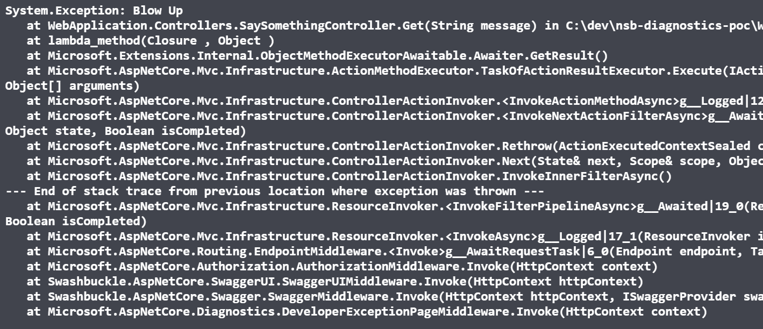
The App
dot exe

Slide 3
Worker Service
API
Other Worker Service

Slide 4
Distributed Tracing
Worker Service
Id:2
ParentId: 1
Id:1
API
Other Worker Service
Id:3
ParentId: 2

Slide 5
Distributed Tracing (Zipkin)
Worker Service
X-B3-SpanId:2
X-B3-ParentSpanId:1
X-B3-SpanId:1
API
Other Worker Service
X-B3-SpanId:3
X-B3-ParentSpanId:2

Slide 6
W3C TraceContext + Activity
Worker Service
Activity.Id:2
traceparent:1
Activity.Id:1
API
Other Worker Service
Activity.Id:3
traceparent:2

Slide 7
Non-HTTP?
Worker Service
Id:2
ParentId: 1
Id:1
API
Other Worker Service
???

Slide 8

Reporting Traces - Zipkin
API
Worker Service
Other Worker Service

Slide 9

Reporting Traces - Jaeger
API
Worker Service
Other Worker Service

Slide 10



OpenTelemetry
API
Worker Service
Other Worker Service

Slide 11
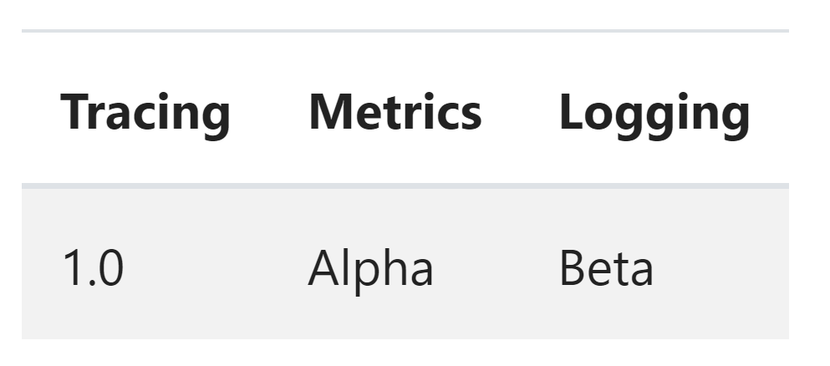
OpenTelemetry in .NET
Logging - Microsoft.Extensions.Logging
Tracing – System.Diagnostics.DiagnosticSource
Metrics – System.Diagnostics.DiagnosticSource

Slide 12
Demo
OpenTelemetry Basics
OpenTelemetry with NServiceBus
Complex “real-world” example

Slide 13
Demo – OpenTelemetry Basics

Slide 14
Demo – OpenTelemetry with NServiceBus

Slide 15
Microservices - GET
Sales API
SQL
Angular UI
Composition Gateway (BFF)
Finance API
SQL
Customers API
SQL

Slide 16
Microservices - POST
Angular UI
Sales API
Sales Endpoint
SQL
SubmitOrder
OrderSubmitted
Finance
Shipping
Customers
InitiatePaymentProcess
ShipViaFedEx
Payment Gateway
PaymentSucceeded
IT/Ops

Slide 17
Using OpenTelemetry with NServiceBus
Jimmy Bogard
@jbogard
github.com/jbogard
jimmybogard.com
github.com/jbogard/presentations

